Slide 1
Indian Clothing 1970- Present
Matt Nazareno, Daisy LaFlamme, Kirsten Fowlks

Slide 2
A background on indian clothing
Dhoti: unstitched 5 yards tied around waistline.
Men wore it,
informal or formal ethnic dress.

Slide 3
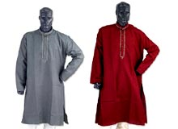
Kurta
Loose long shirt, falls just below knees.
Older times worn by men; now can be unisex.
Could be formal/informal
Traditional do not have any collar and openings are centered off chest.
Notes:
Made from a rectangular piece of fabric. Typically used for everyday wear because its comfort.

Slide 4
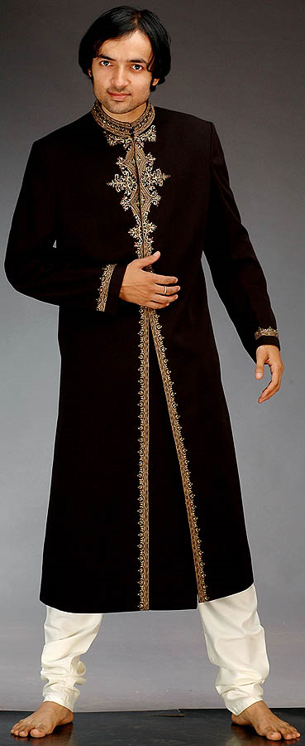
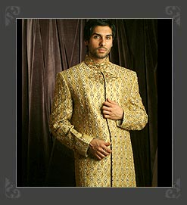
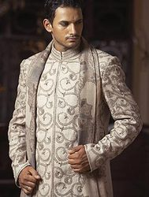
Sherwani
Long coat like style
Traditional wear
Can be worn Formal events.
Notes:
National dress for Pakistani men. Famous as a wedding outfit.

Slide 5
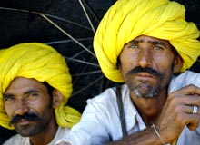
Turban
Not for fashion
5meters long
Initially was tied to keep head cool from sun. Was soaked in cold water at night & tied in morning.

Slide 6
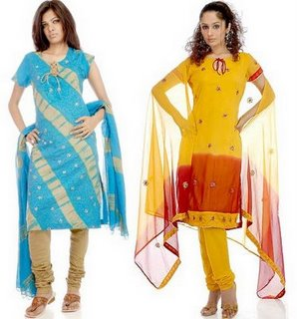
Salwar kameez
Salwar looks like pajama bottoms that end at ankles
Kameez is the long shirt
This is traditional wear
Can be used with a dupatta
Notes:
Dupatta is a long scarf generally used around the head or neck.

Slide 7
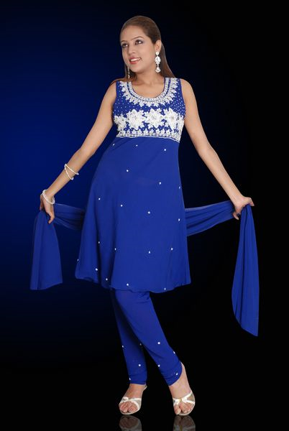
Churidar
Churidar tighter version of the salwar kameez
Emphasis the ankles and the knees.

Slide 8
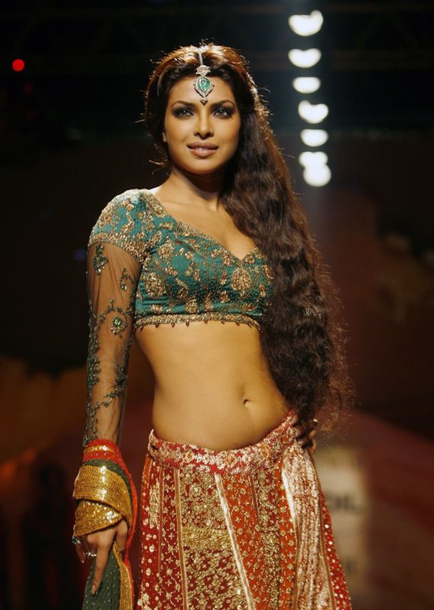
Ghagra- Choli
Gharga/ skirt
Choli/blouse
Notes:
A balance of modern and traditional wear.

Slide 9
Importance of Colors
Green and Red symbolize fertility therefore, young women wear these colors.
Red, green, and yellow are festive colors
Purple is for older people.
Unstitched: Rich, Stiched: Poor
Red is often a color in marriage
Odhni, is the scarf
Hero & Heroine will have some matching colors to symbolize that they are on the same wavelength.
Notes:
Rich people do not want their clothes touched by poor people, who are the ones that stich clothing.

Slide 10
The Influence of Bollywood
Bollywood has an influence on the fashion trends of common Indians.
In the 60s, heroines were coy; and so were their clothing
The 70s was the most influential
It is considered a turning point for both female empowerment and clothing.

Slide 11
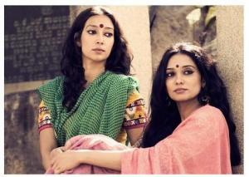
1970s

Slide 12
What Changed?
Saree blouse designs, accessories; all of them became bolder
There were two main styles in the 70s. The retro and the disco.

Slide 13
Actors influence
The actors influenced style; by wearing something new it caught peoples attention.
In film: Mumtaz sarees: see through layered.
Individual wants to have something that is worn by their preferred film stars.
Notes:
They made a new way of wearing saris by wrapping it twice.

Slide 14
New kinds of styles
Synthetic transparent sarees paired with low neck laced blouses.
Patterned cotton sarees
South Indian silk sarees with heavy jewelry.
Chiffon sarees with halter neck, high neck, noodle strip blouses
5 yard sarees with small pallu (patterned end)
Salwar kameez

Slide 15
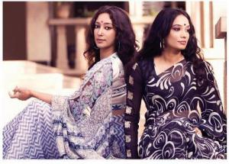

Slide 16
1970 Male styles
Cloth jacket, leather jackets, butterfly collar shirts, & cloth trousers with flares
3 piece suit started to become popular
Disco and retro wear.

Slide 17
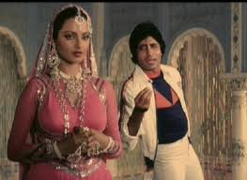
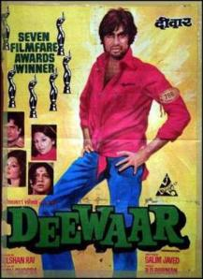
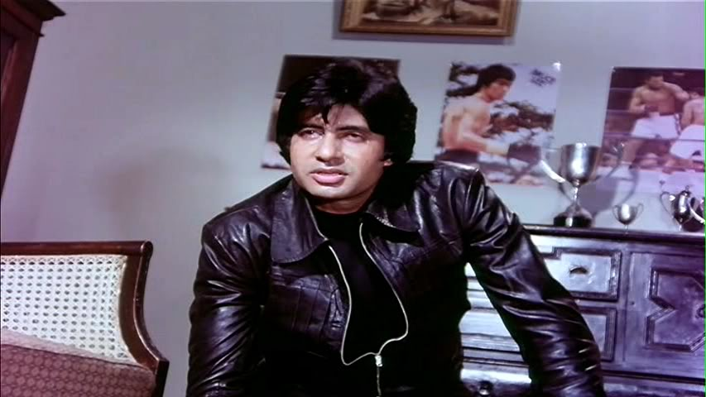
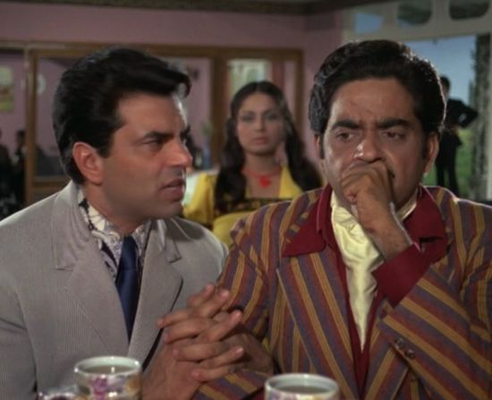

Slide 18
1980s
Strappy sandals, fitted pants or denim, color became a must.
White pants & white shoes,
Plain colored sarees

Slide 19
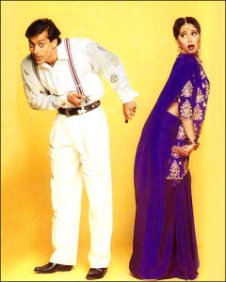
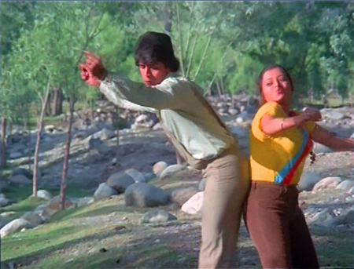

Slide 20
1990s
Men: waistcoats, baggy pants, print ties, dungarees, colorful denim, t shirt under oversized shirt.

Slide 21
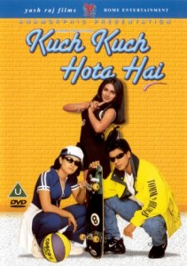

Slide 22
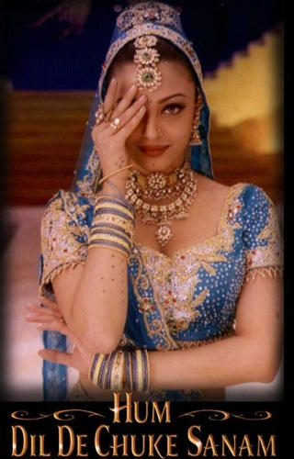
Women Fashion 1990s
Colourful Bandhni, shoulder pads, scarves, chunky jewelery, ankle high boots, tight fitted skirts, hair bands, big decorative bindis
Matt Lipsticks

Slide 23
2000
Men: Fitted shirts, fitted pants and jeans.
Women: vintage (classy), designer clothing, short dresses.
More style: hair, pedicure, grooming.
Modern day look.

Slide 24
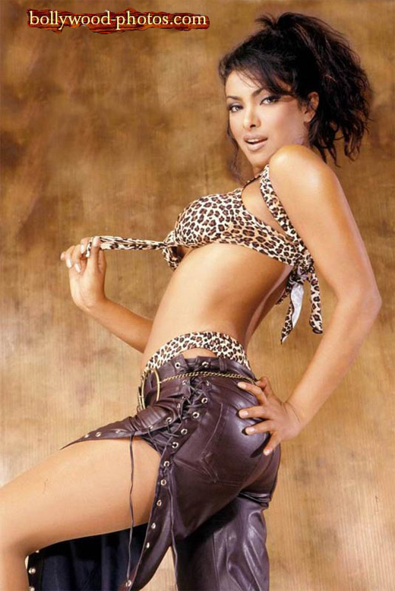
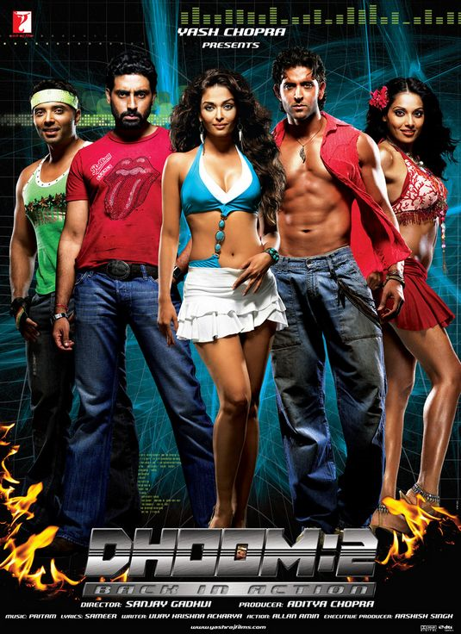

Slide 25
Present Day Fashion
Bollywood can be a catalyst for booming Indian retail trade sector and push merchandise worth over four billion dollars in the next two years.
Accessories
Notes:
Jewelry, and colorful handbags.

Slide 26
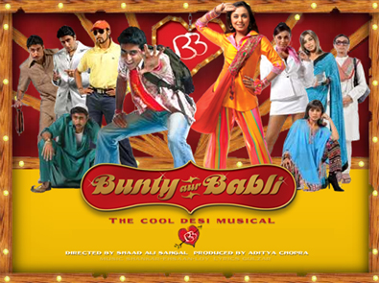
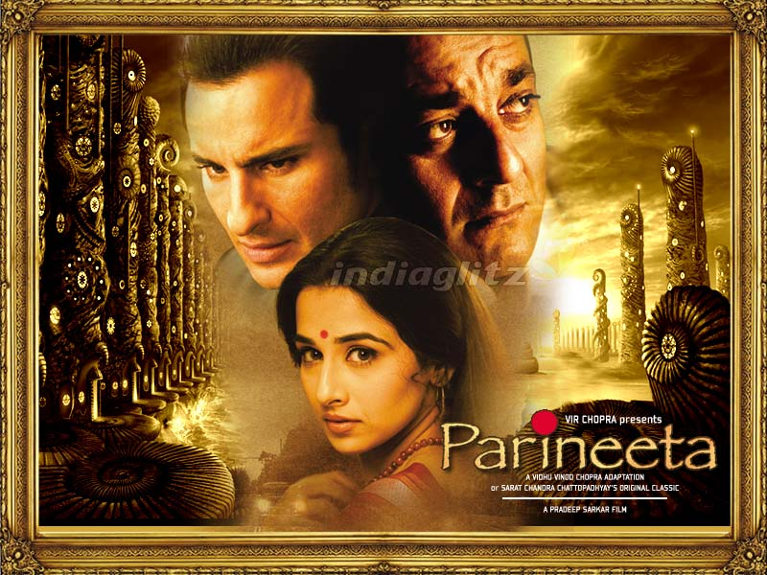
Movies that Influenced Fashion
Bunty Aur Babli dresses, Parineeta blouses, and Hum Tum sarees

Slide 27
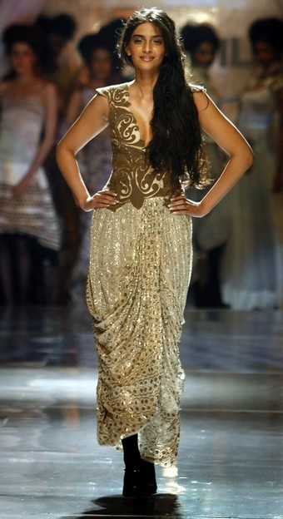
2010
Indian Fashion goes International with Anamika Khanna, 2010
the blingy and glitzy dresses of yesteryears were toned down into softer hues with liberal use of gold and silver.
compromise between the uber modern and the traditional.
The dresses are sure to cater to modern demands as well as keep the in-laws happy.
keeping in mind both the modern scenario as well as indian cultural heritage.
Notes:
http://sareez.wordpress.com/2010/08/14/anamika-khannas-bridal-collection/

Slide 28
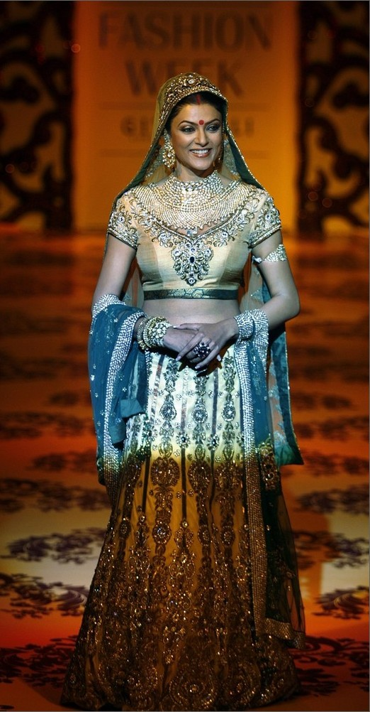
Lakmé Fashion Week 2010
Lakme Fashion Week has been conjured up and created with a vision to redefine the future of fashion and integrate India into the international fashion world
colours are a combination of soft, shaded pastels, bright solid pastels, traditional jeweled shades
golden with heavy embroidery sets an unique example of the custom of India
the pallu of the saree is specially designed in handwork, sequences, patchwork
Notes:
http://sareez.wordpress.com/2010/03/17/the-folklore-in-lakme-fashion-week/

Slide 29
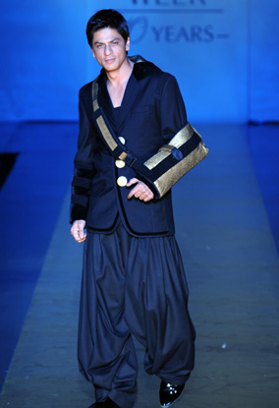
Lakmé Fashion Week 2010
Shah Rukh Khan wearing a sling, Katrina Kaif wearing Barbie’s outfit and Akshay Kumar unbuttoned by wifey Twinkle
Notes:
http://www.fashion4chill.com/shahrukh-khan/the-lakme-india-fashion-week-2010/

Slide 30
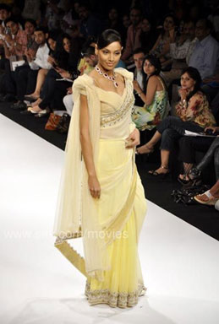
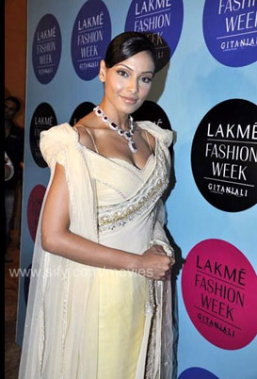
Traditional, modern,trendy, beautiful lemon sari
Notes:
http://sareez.wordpress.com/2010/03/17/the-folklore-in-lakme-fashion-week/

Slide 31
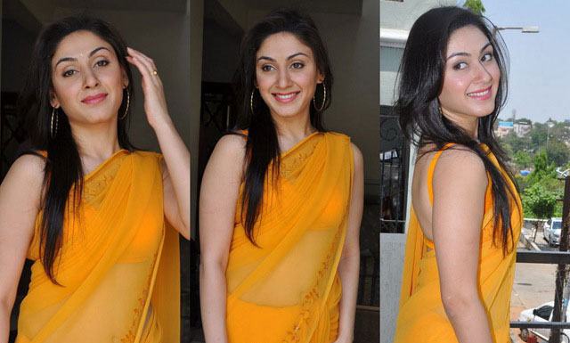
Bollywood and South Indian actress Manjari looks stunning in gorgeous yellow sari with embroidered border sari paired with a sexy sleeveless blouse
.
Notes:
http://sareez.wordpress.com/2011/04/18/sizzle-like-a-bollywood-diva-in-our-fabulous-yellow-silk-sarees/

Slide 32
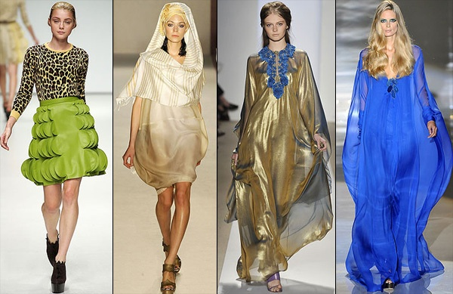
Southern India’s Innovation in Sarees
The Color-Changing
sareeThe Saree-Shirt
ComboThe Zip-n-Wear
SareeThe Denim Saree
The Pocket Saree
ReversibleSaree
Krishna Saree
The 50000 Color Saree
The Zodiac Saree

Slide 33
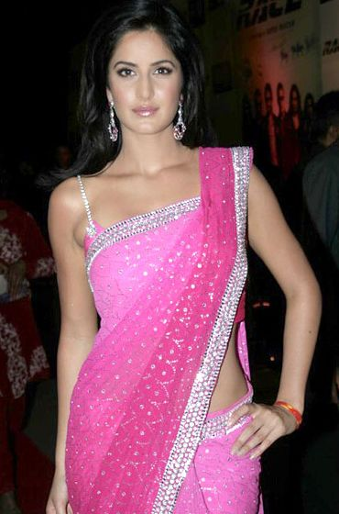
Katrina Kaif
Now Bollywood sarees are made according to the needs and demands of the fusion of cultures or based on some sort of theme.
Chiffon, georgette, silk and crepe are the favored fabric of Bollywood.
Notes:
http://sareez.wordpress.com/2011/03/11/latest-trends-in-bollywood-sarees/

Slide 34
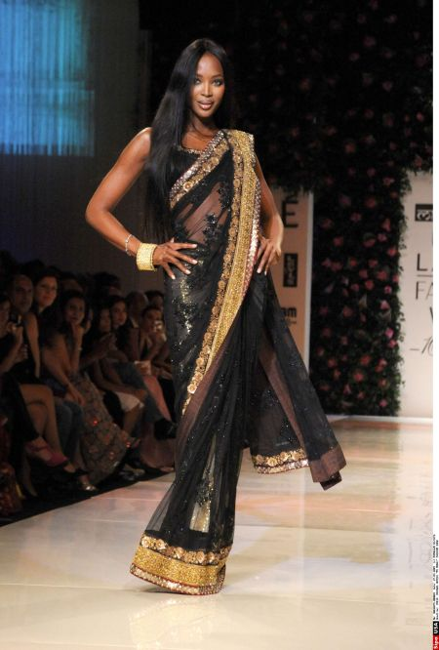
Filmfare Awards 2011 became an Exhibition of Sarees
Black Sabyasachi Mukherjee Saree
Notes:
http://sareez.wordpress.com/2011/03/07/filmfare-awards-2011-became-an-exhibition-of-sarees/

Slide 35
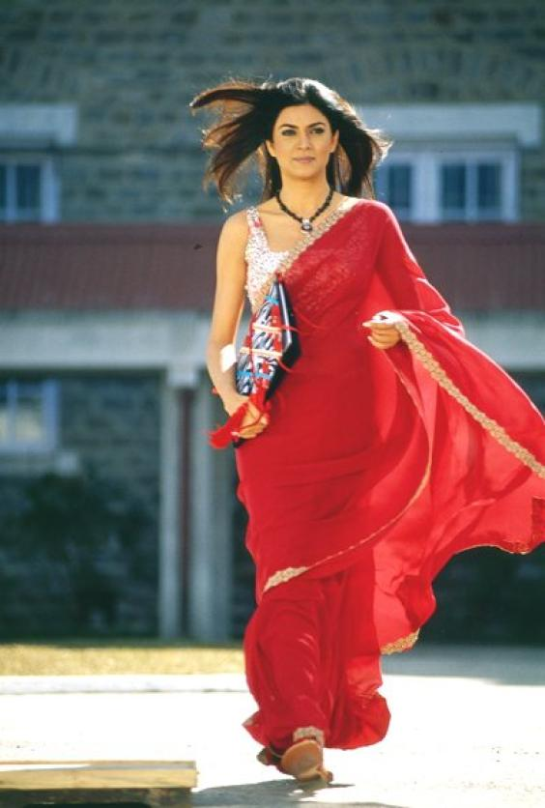
Sarees used in Bollywood Movies
Susmita Sen in her red chiffon saree as hot chemistry teacher in the movie Main Hoon Naa

Slide 36
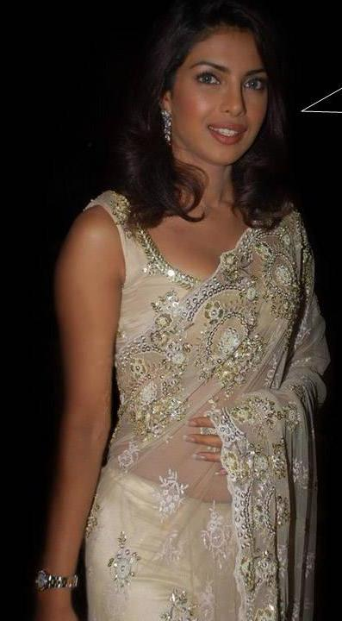
Sarees used in Bollywood Movies
Priyanka’s look was smoking hot in sparkling georgette saree and halter blouse in rocking ‘Desi girl’ song.

Slide 37
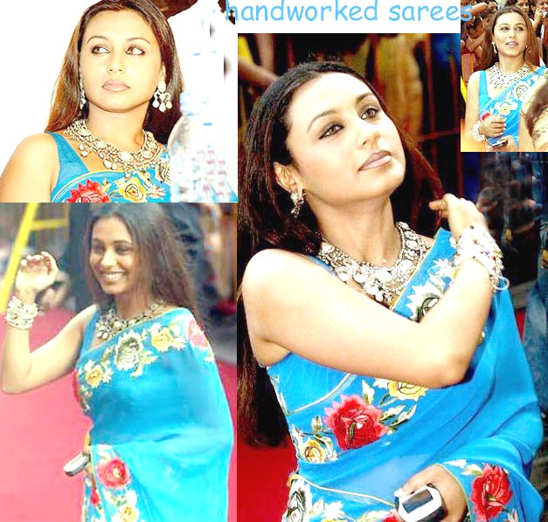
Rani Mukherjee
handmade embroidered saree

Slide 38
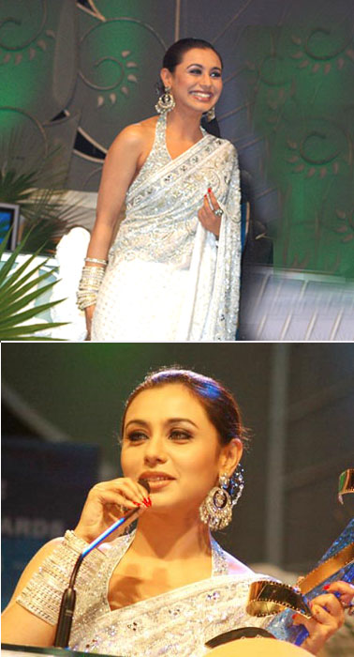
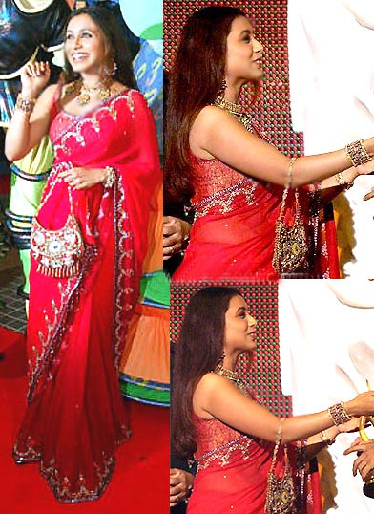
Rani Mukherjee

Slide 39
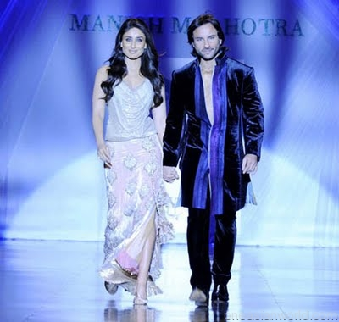
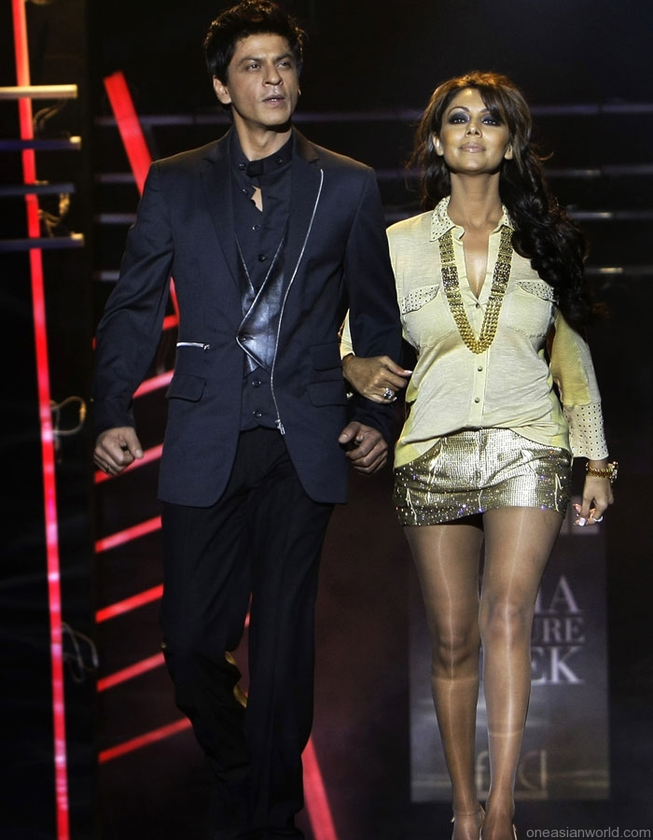
Bollywood male fashion

Slide 40
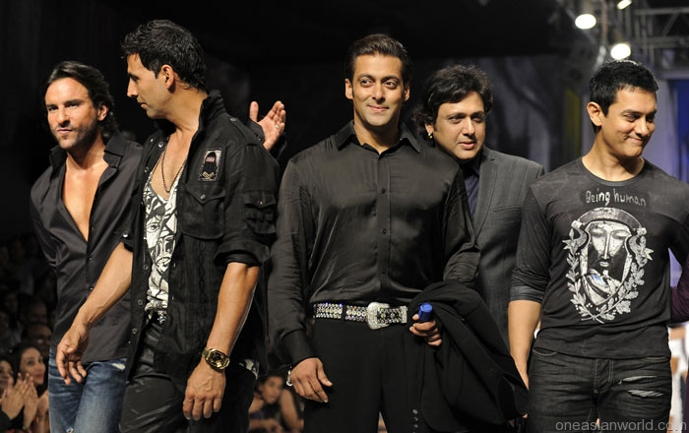
Bollywood male fashion
Notes:
http://www.google.com/search?q=bollywood+male+fashion&hl=en&client=firefox-a&hs=pt1&rls=org.mozilla:en-US:official&prmd=ivns&tbm=isch&tbo=u&source=univ&sa=X&ei=oBe5TceAGYGatwe90dTeBA&ved=0CDsQsAQ&biw=1280&bih=608

Slide 41
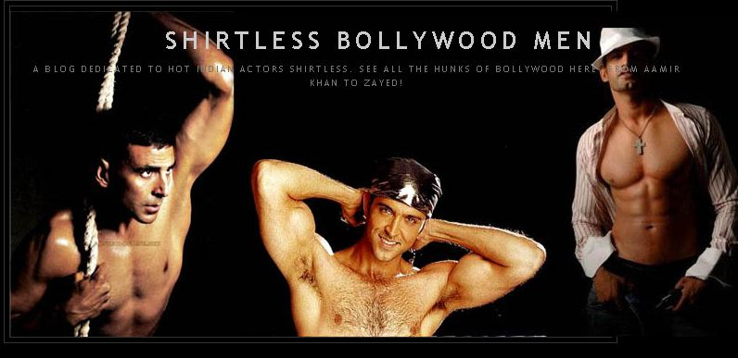
Shirtless Bollywood Man

Slide 42
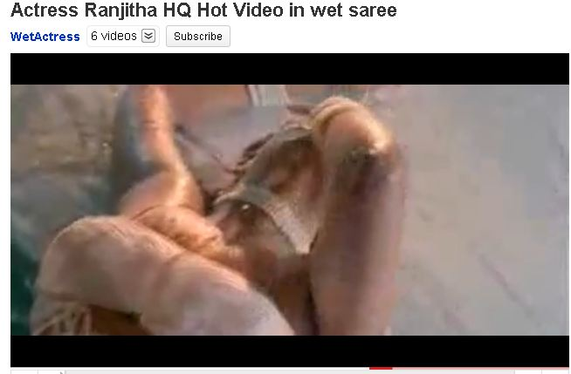
Wet Saree

